Slide 1
Budget Process in Latvia

Slide 2
Definition and Purpose of the Budget
Budget is a tool for implementation of the state policy through financial methods
The budget is the foundation for financial activities and management of the government
The purpose of the budget is to determine and substantiate the resources required for the central government and local governments to perform the state duties whose financing is determined by legislative acts
It is necessary to ensure that expenditure is covered by corresponding revenues
When formulating the budget, the necessity of ensuring an overall economic balance shall be taken into account

Slide 3
Hierarchy of Legal Acts
Constitution
Fiscal Discipline Law
Law on Budget and Financial Management
Regulation of Cabinet of Ministers
Internal acts of institutions
International legal acts
Annual Budget Law
Medium Term Budget Framework Law

Slide 4
Definition and Purpose of the Budget
Law on Budget and Financial Management determines the procedures for:
formulation
approval
implementation
responsibilities in the budget process
reporting

Slide 5
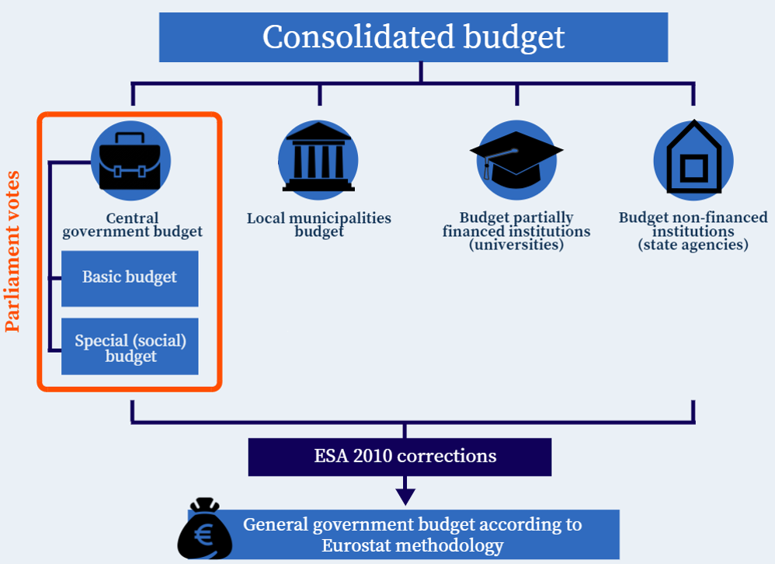
Budget System in Latvia

Slide 6
Budget Structure
Budget program – a program of such mutually connected measures or services that are oriented to a common objective, which is planned, implemented, recorded and controlled by bodies financed from the budget in accordance with the Law and regarding which implementation the persons implementing the budget are liable. The budget program may be divided into subprograms (approximately 500 budget programs and subprograms)
Budget classifications:
  Revenues classification,
  Expenditures classifications:
    Economic,
    Functional (COFOG 10 functions),
    Institutional
  Classification of sectors;
  Financing classification.

Slide 7
Strengthening Medium Term Budget Planning by Introduction of Medium Term Budget Framework Law (from 2012)
Is prepared every year on «rolling» basis for the next three year period and approved by Parliament
Ensures strategic view and link between policies of the governments and budget resources available (top-down budgeting)
Is subject to Fiscal Discipline Law requirements, thus ensuring implementation of responsible and sustainable fiscal policy
Serves as a basis for preparation of Annual Budget Law

Slide 8
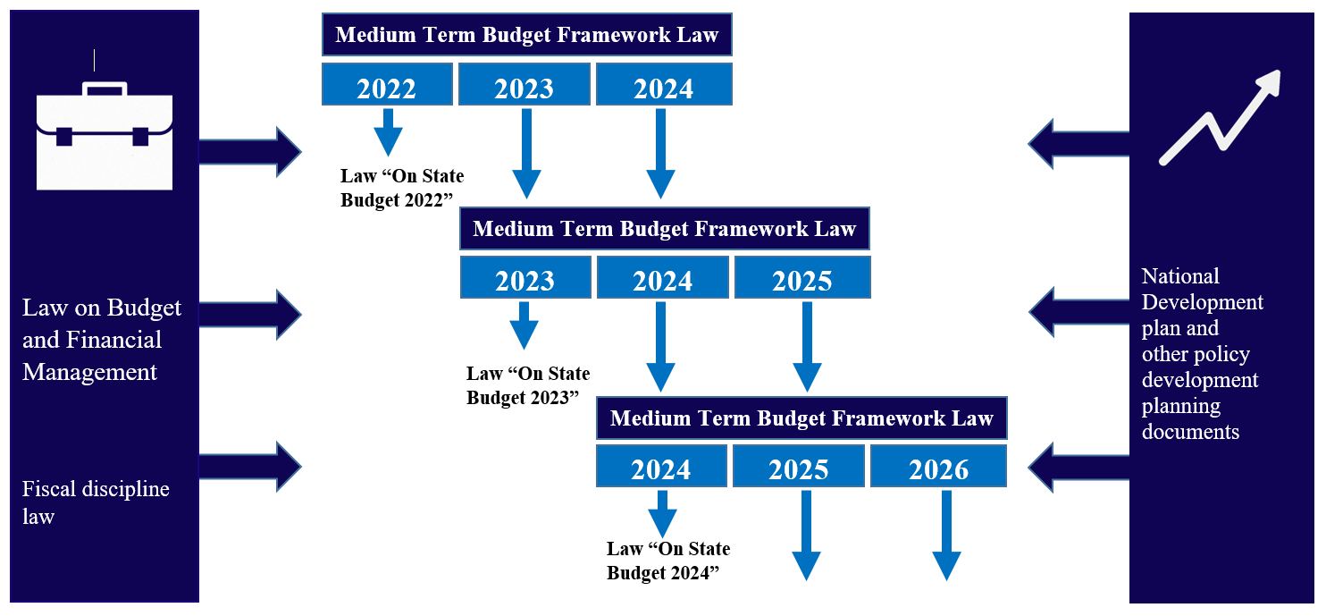
Medium Term Budget Planning System

Slide 9
Fiscal rules and procedures imposed by Fiscal Discipline Law
Rules:
budget balance rule – structural budget deficit of general government can not exceed 0,5% of GDP. If it does (escape clauses, unforeseen events), the future balances have to be planned in such amounts, to adjust the deviations to normal level
expenditure rule - general government real expenditure growth does not exceed average potential GDP growth
debt rule – general government debt must not exceed 60% of GDP
Procedures:
inheritance principles getting from Framework Law in force to new draft Framework Law
limitations on amendments to Framework Law
limitations on drafting Annual Budget Law with respect to requirements of Framework Law
limitations on amending Annual Budget Law with respect to requirements of Framework Law
limitations on budget execution with respect to requirements of Framework Law
limitations on interim decisions of the government with fiscal impact
escape clauses for all aforementioned and mechanisms for getting “on road” in cyclical terms.

Slide 10
By adopting Fiscal Discipline Law (in 2013), the CoM and Parliament have committed themselves to the following principles
principle of being economical
fiscal policy shall be implemented allocating available resources reasonably and efficiently
principle of making savings
fiscal policy shall be implemented so that the budget is planned and implemented with surplus, if the economic situation allows, which allows covering future liabilities in case of worsening of the economic situation
principle of counter-cyclical fiscal policy
a counter-cyclical fiscal policy shall be implemented running counter to trends of the economic cycle
principle of stability
financial policy shall be implemented so that it contributes to the economic growth and financial stability and is foreseeable and successive in medium term
principle of sustainable fiscal policy
fiscal policy that focuses on the maintenance of the general government debt level which does not impose a disproportionate burden on the economy, but contributes to its long-term development.
principle of generation mutual responsibility
a fiscal policy takes into account the financial impact on the society now and on future generations
principle of transparency
information on fiscal policy objectives, methods for their achievement and results shall be publicly available
principle of fiscal discipline solidarity
institutions within general government assume the constraints derived from fiscal rules in solidarity manner

Slide 11
Budget Process and Parties Involved (I)
MoF prepares medium term macro development forecasts, calculates fiscal restrictions
In cooperation with line ministries performs spending review and calculation of base expenditure
Evaluates proposals for priority measures
Aggregates budget requests received from line ministries
Prepared draft budget law and medium term budget framework law and submits it to CoM
Line ministries participate in calculation and review of base expenditures
Prepare proposals for priority measures
Prepare and submit budget requests according to decisions taken by CoM
Take part in debate on the draft budget law in the CoM

Slide 12
Budget Process and Parties Involved (II)
CoM approves fiscal goals of the state and the Stability Program
Takes decision on results of spending review
Takes decision on priority measures that should receive additional financing in future years
Submits draft budget law and medium term budget framework law to Parliament
Discussions in the Budget Committee.
Parliamentarians formulate propositions to draft budget
Parliament approves state budget law and medium term budget framework law in two readings
President of the Republic of Latvia announces the state budget law and the medium term budget framework law

Slide 13
Preparation of draft framework law and draft annual budget law in Latvia

Slide 14
Planning System
State budget for the next year and for the medium term
Fiscal Discipline Law
(fiscal rules and principles)
Fiscal requirements on state level
National Development Plan
Other policy planning documents
(medium term policies and expected results in different industries)
State priorities
EU dimension
(Stability program, EU requirements)
Targets of the state
Law on Budget and Finance Management
(budget process)
Budget preparation and execution procedures

Slide 15
Central government budget maximum allowable expenditure
A+B = Maximum allowable expenditure
Incremental funding for government priorities:
Priority measures, based on National Development Plan, Government declaration and sectoral planning documents
A
B
Base expenditure:
Resources needed to maintain functioning with no policy change

Slide 16
Incremental funding – priority measures
Submission and evaluation –
unified,
simple and
effective
approach
Emphasis put on priority measures contribution to economic development and structural reforms
Highlighted a link between policy measures and policy goals, concrete measurable results, tasks in Government Declaration
Within reasonable limits stimulated re-prioritization of resources of line ministries towards development of particular areas and the whole economy

Slide 17
Submission of proposals for priority measures – simple, effective and oriented towards restructuring internal resources towards development of the economy
Ministries submit short and concise proposals for priority measures
(and indicate possibilities to finance them from internal resources)
Minister of Finance is responsible for organizing the evaluation process of proposals for priority measures
(discussion or working group)
MoF acts as a secretariat
The proposals for priority measures should be oriented mainly towards
- economic growth,
- development of sectoral activity
- implementation of structural reforms
As a result of evaluation process, Minister of Finance formulates proposals for acceptable (financeable) priority measures
CoM approves priority measures for the next years
Ministries submit to MoF adjusted proposals according to taken decisions
June September

Slide 18

Content of proposal for priority measures
Goal and description
Correspondence to Government declaration
Correspondence to medium term priorities according to MTEF
Related policy performance indicators (outcomes)
Expected operational performance indicators (outputs)
Required funding
Impact on economic development and structural reforms
Available funding within ministries’ budget
Other important information
Proposal for priority measure

Slide 19

Budget Explanations (I)
Aim of budget explanations– to provide information on budget as a tool for realisation of government policy
Result
Society is provided with understandable and wholesome information about planned budgetary resources
The link between strategic planning documents and budgetary resources is revealed
Orientation towards achievement of political goals
Information on resources, goals and multi-level indicators is available in one place, providing better possibility to perform analysis later on
Additional funding for priority measures is supplemented by separate operating indicators (with an aim later on to monitor factual execution of these)
Structure and content of budget explanations is optimal and ensures fair administrative burden

Slide 20

Budget Explanations (II)
Key element of budget explanations – Policy and resource management scorecard
Content of the Card for every activity areas
(plan for the medium term and fact for the previous year):
Goal | which is planned to be achieved in a particular activity area
Policy performance indicators | which are derived from policy planning documents and characterize to what extend the goal is achieved
Resources (inputs) | expenditure number of employees infrastructure, tangible and intangible assets, which are significant for the achievement of goal
Operational performance indicators | the most inclusive and concise
Quality indicators | Intangible evaluation of activity area (quality, satisfaction surveys)
The idea about creation of Policy and resource management scorecards was developed and tested during the first budget spending review process

Slide 21
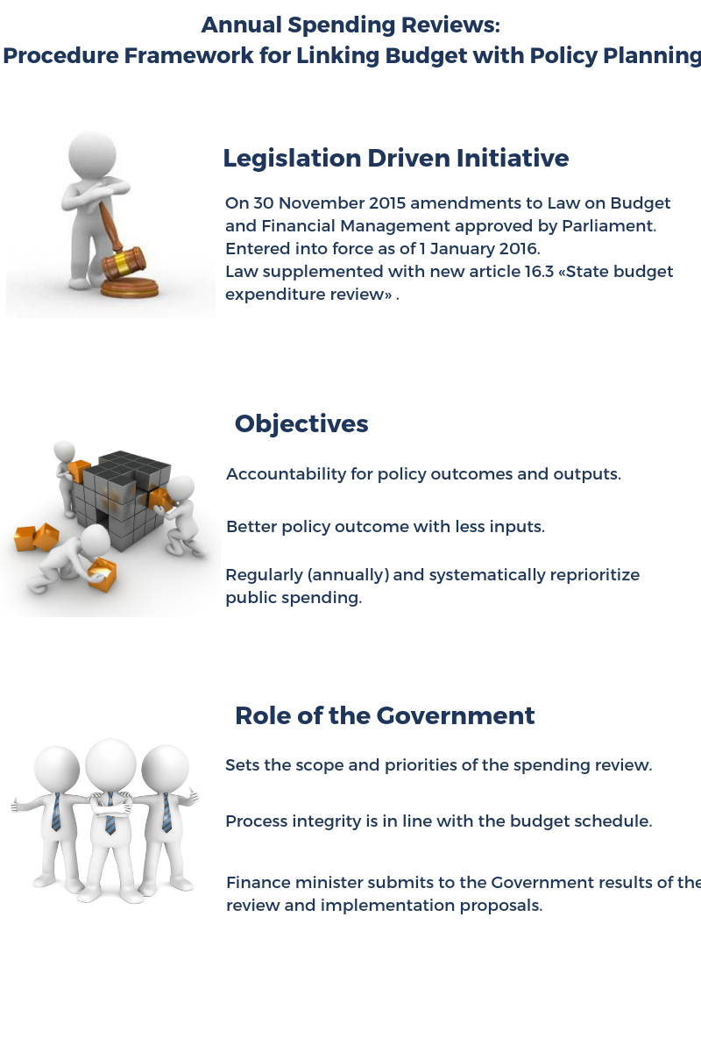
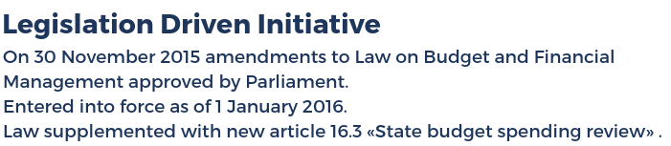
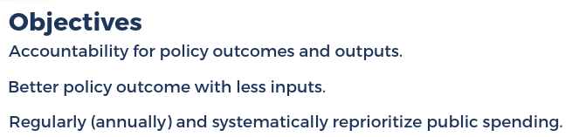
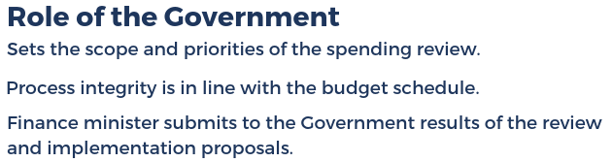
Annual Spending Reviews:
Procedure Framework for Linking Budget with Policy Planning

Slide 22
Most Characteristic Examples of Using Performance Information at all Stage of Budgeting
After Parliamentary Adoption
Annual Spending Reviews
Previous spending measures – actual outputs, outcomes & costs VS planned – as of 2016
New Spending Measures & Initiatives
Specific & measurable objectives
Budgetary Requests & Parliament
Policy and resource management scorecards – as of 2016
Estimated effects on policy outcomes & expected outputs
Relevance & topicality of historical spending measures– as of 2017
Shifting performance analytics from budget programs to policy areas– as of 2016
Easy-to-understand info graphs about spending and public benefits (outcomes & outputs – as of 2016)
Interactive budget – as of 2017
Framework revised in 2017
Intensive public communication, emphasis on visualizations

Slide 23
Structure of State Budget Law
Law (text)
Budget financial balance and the maximum permissible amount of the national debt
Law (Annexes)
14 annexes, approx. 362 pages, 526 budget programs
Summary of tax and non-tax revenue and expenditure
Explanations
Approx. 1 000 pages
Information concerning the economic situation and a description of the macroeconomic strategy
GDP forecasts
Provisions to be attached to all or individual appropriations
Specific rights and duties for particular budget institutions
Provisions for social insurance budget revenue distributions
Other specific regulations for particular year
Approx. 17 pages,69 Articles
Expenditures (appropriations) detailed by budget programs and economic classification codes
Dotation to local municipalities
Maximum permissible amount of state guarantees
Central government budget long term liabilities
Revenues analysis
Explanations on expenditures and new measures
Results and performance indicators of budget programs
Summary of budget expenditure by administrative and functional classification
Information about investment projects
Information about other laws included in budget law package

Slide 24
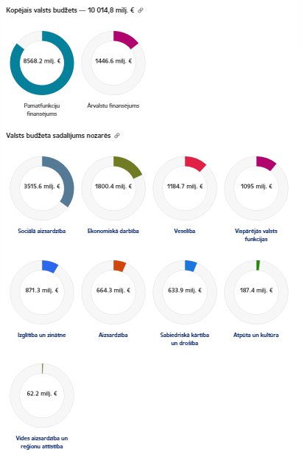
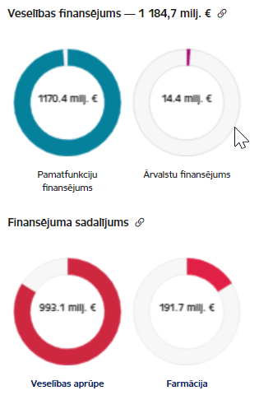
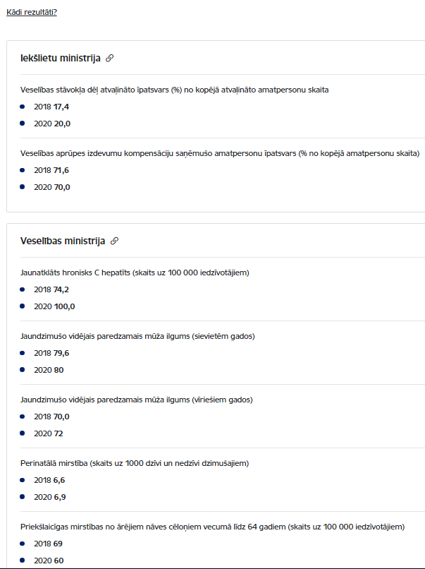
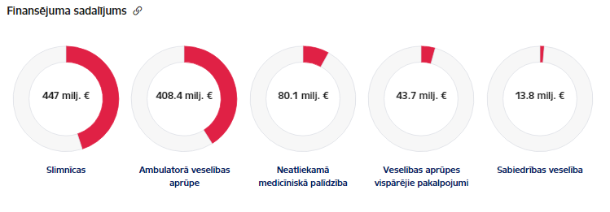
Interactive Citizen’s Budget from 2017 – Presenting Numerical Annexes of Budget & Public Benefits (Outcomes)
Step 1: €
Step 4: Outcome
Step 2: €
Step 3: €
https://www.fm.gov.lv/lv/interaktivais-budzets2020

Slide 25
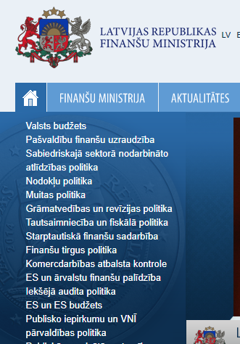
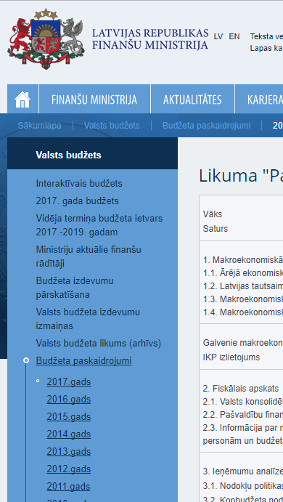
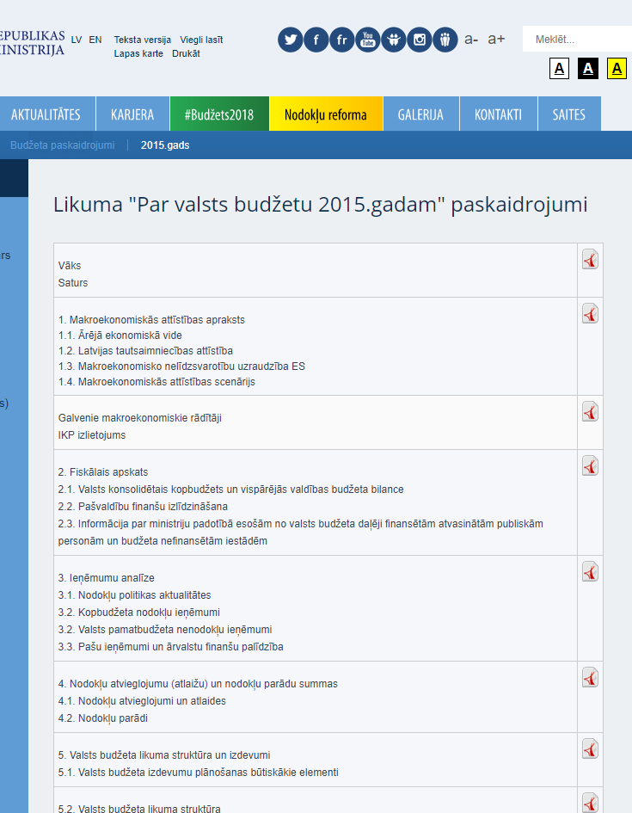
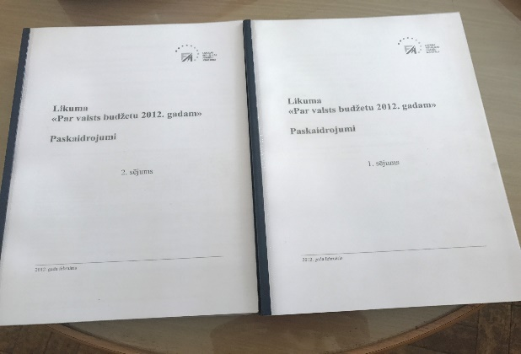
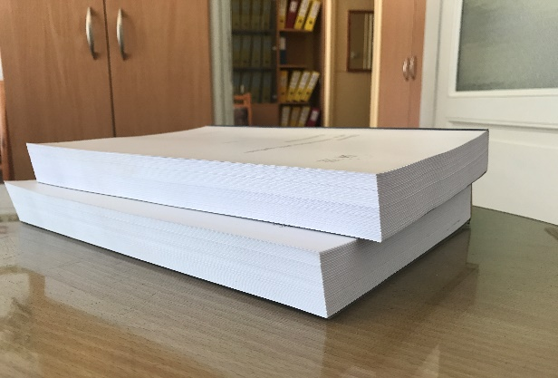
Budget Explanations Until 2016 – Two Volumes Printed and Published, Scarcely Read by Anybody
Table of Contents with Respective PDF Document
Section for Budget
Subsection for Budget Explanations
Printed Version

Slide 26
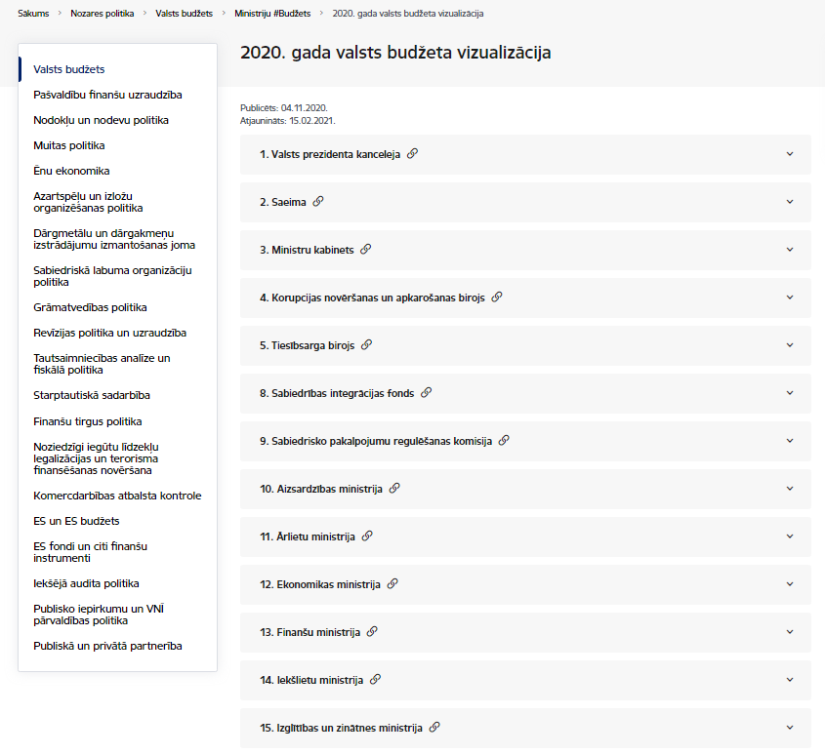
Budget Explanations from 2017 (1)
Step 1
Line Ministries
https://www.fm.gov.lv/lv/2020-gada-valsts-budzeta-vizualizacija

Slide 27
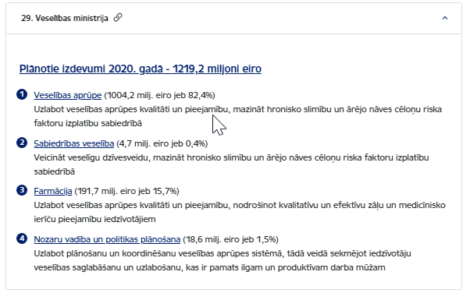
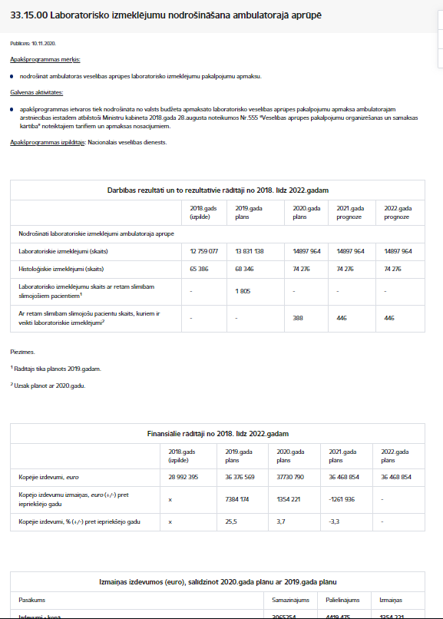
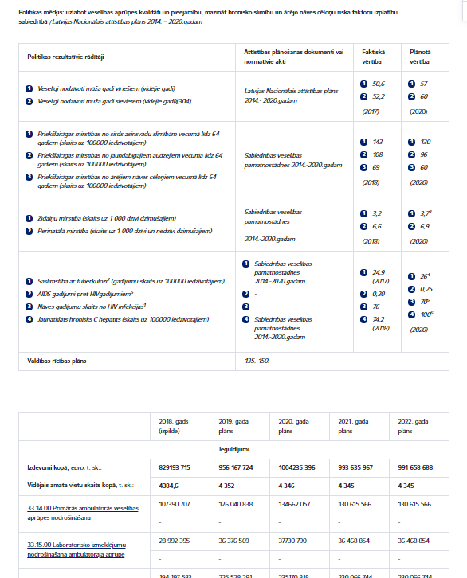
Budget Explanations from 2017 (2)
Step 2
Step 4
Policy areas
Detailed Info About Inputs for Each Program
Step 3
Policy & Resource Management Scorecards

Slide 28
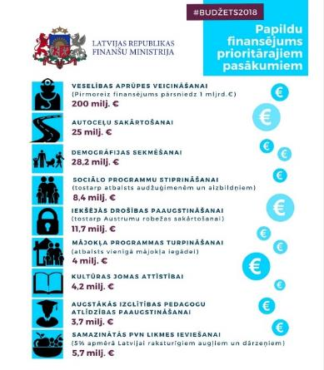
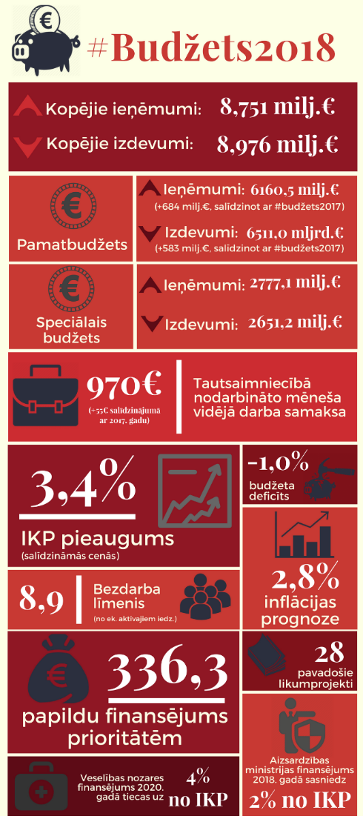

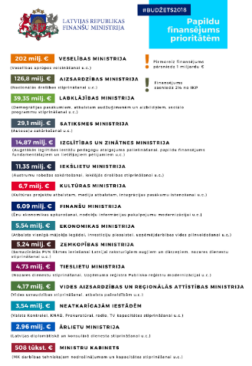
Way of Speaking Simple & Short– Infographics & Visualizations

Slide 29
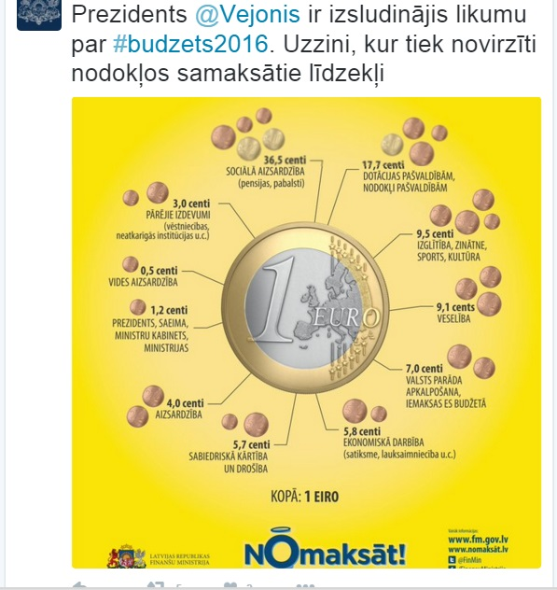
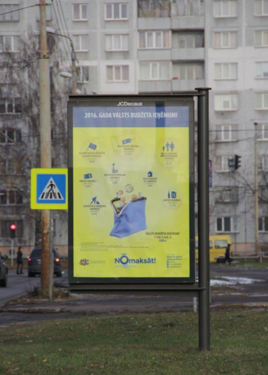
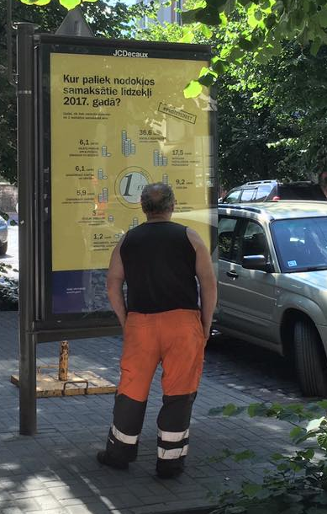

Being Everywhere – Social Networks, Streets, Newspapers, Television etc.

Slide 30
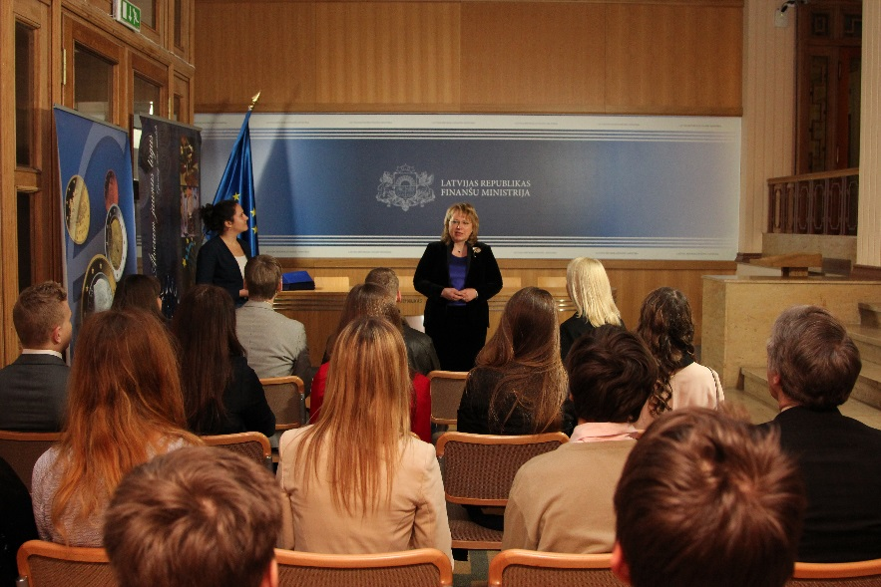



Involving and Speaking with Youth – «Shadow Days» and «Open Door Days»

Slide 31
Thank you!
Smilšu street 1, Rīga, LV-1919, Latvia
Phone: +371 67 095 405
Fax: +371 67 095 503
E-mail: info@fm.gov.lv
Homepage: www.fm.gov.lv

